Slide 1


SAP CLOUD APPLICATION PROGRAMMING AND XSA TRAINING IN BTP
Anubhav Oberoy
Day – 1

Slide 2

INTRODUCTION

Slide 3

Agenda – Day 1
Introduction to SAP BTP and Cloud Foundry
What is SAP BTP?
Setup Account for SAP
What is Cloud Foundry?
SAP Cloud Foundry Architecture
Why use Cloud Foundry
History of Cloud Foundry
Development Tools Setup
Deploying a sample application to CF
Introduction to NodeJS
Basic of JavaScript
Functions in JavaScript
Asynchronous Behavior of JavaScript
Concept of Events in NodeJS
Introduction to Node Package Manager (NPM)
Accessing the global modules
Steps to Initialize a NodeJS Project
Creating a server using NodeJS and Express module
Creating Microservice using NodeJS

Slide 4
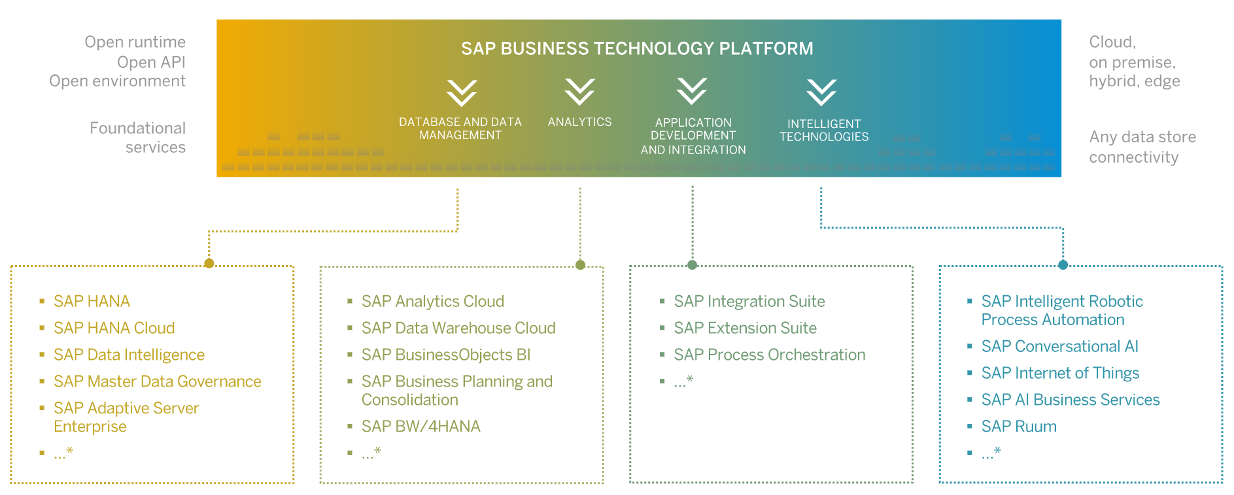
What is BTP?
SAP Business Technology Platform (SAP BTP) is an integrated offering comprised of four technology portfolios: database and data management, application development and integration, analytics, and intelligent technologies. The platform offers users the ability to turn data into business value, compose end-to-end business processes, and build and extend SAP applications quickly.

Slide 5
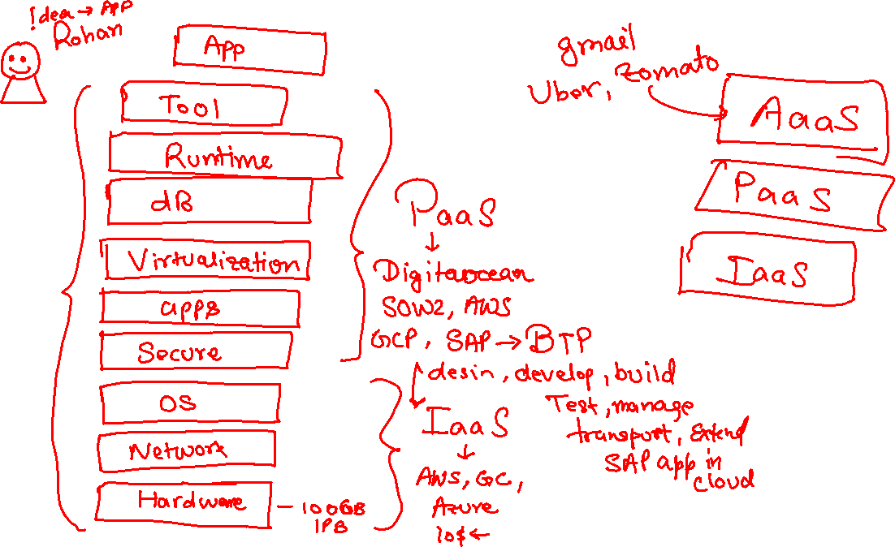

Slide 6
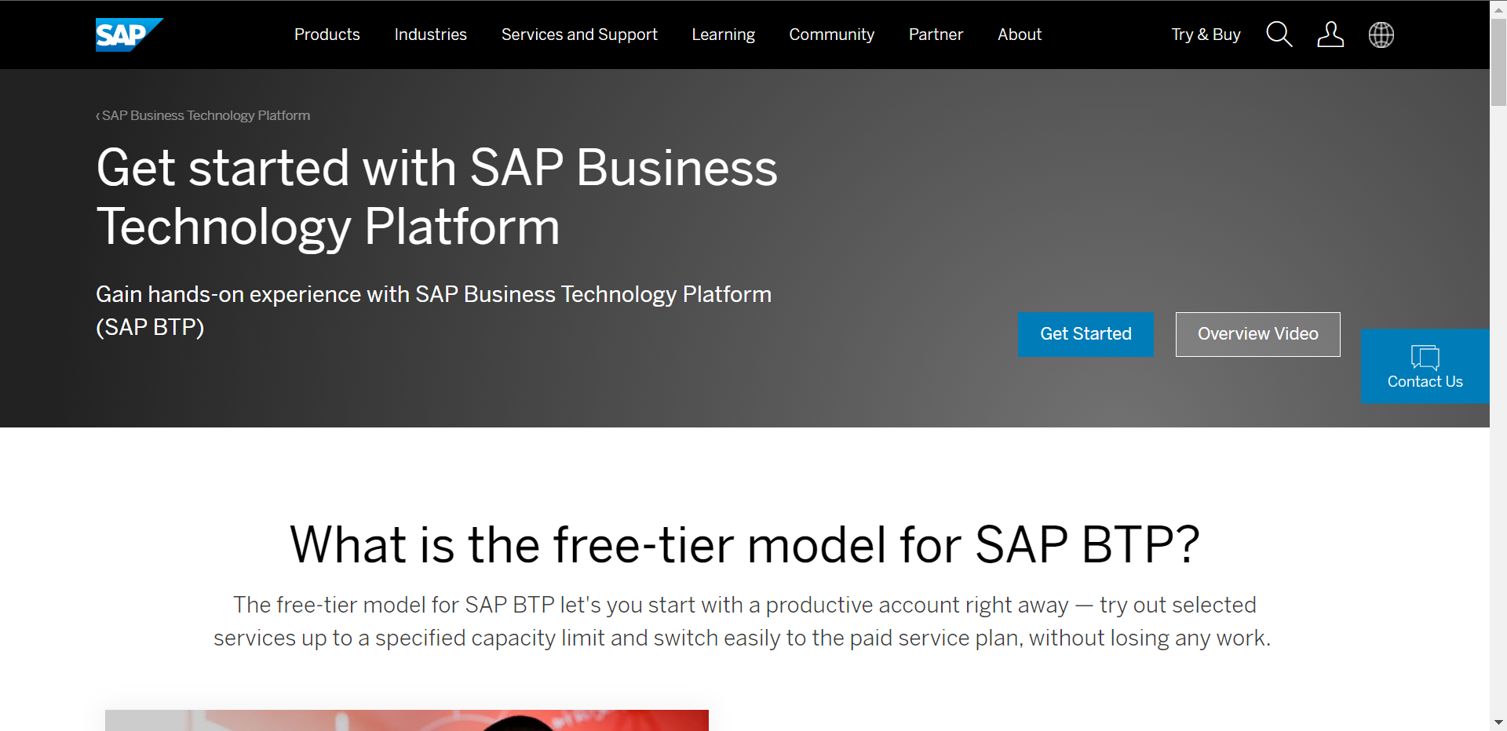
Setup Your FREE Account
To use SAP Business Technology Platform first you need to create a account on sap.
You can setup a free account for SAP at https://www.sap.com/products/cloud-platform.html
After account setup to access the Business Technology Platform trial account visit: https://account.hanatrial.ondemand.com/trial/#/home/trial

Slide 7
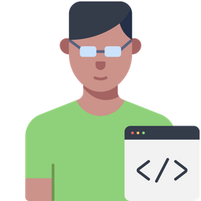



WHAT IS SAP CLOUD FOUNDRY?
Application
Application
Data
Data
Runtime
Platform as a Service
Managed by SAP implementing open source CF
Middleware
Fully ready landscape with reusable services
Scalability
Elasticity
Low TCO
Database
OS
Managed by Infrastructure
providers
Data Centers
Service Portfolio
Virtualization
Infrastructure as a Service
Servers
Storage
Networking

Slide 8
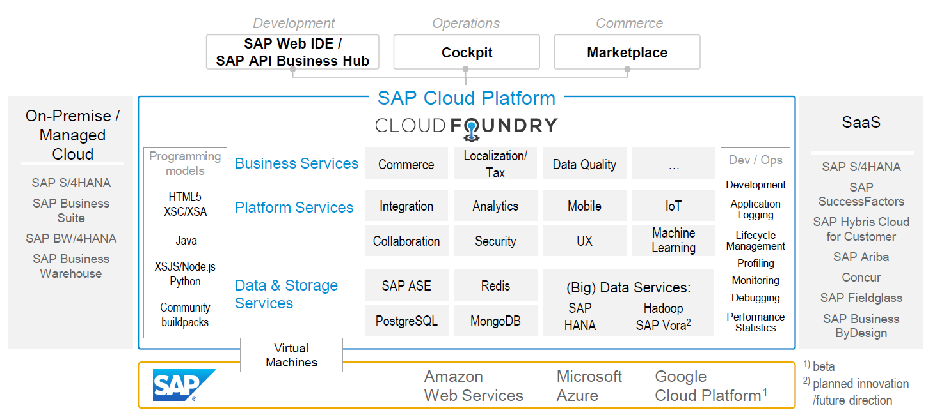
SAP CLOUD FOUNDRY ARCHITECTURE

Slide 9





Why CF (1)
1
Support full development lifecycle
Build Application & Services
Development
Continuous Delivery (CD) = Code ➔ Push ➔ Test ➔ Build
Continuous Integration (CI) = Dev ➔ Quality ➔ Production
Up and Down
Deployment
Testing
Monitor and Upgrade

Slide 10

Why CF (2)
2
Self healing container management system
Cell
Garden = execution
Containers
A

Slide 11
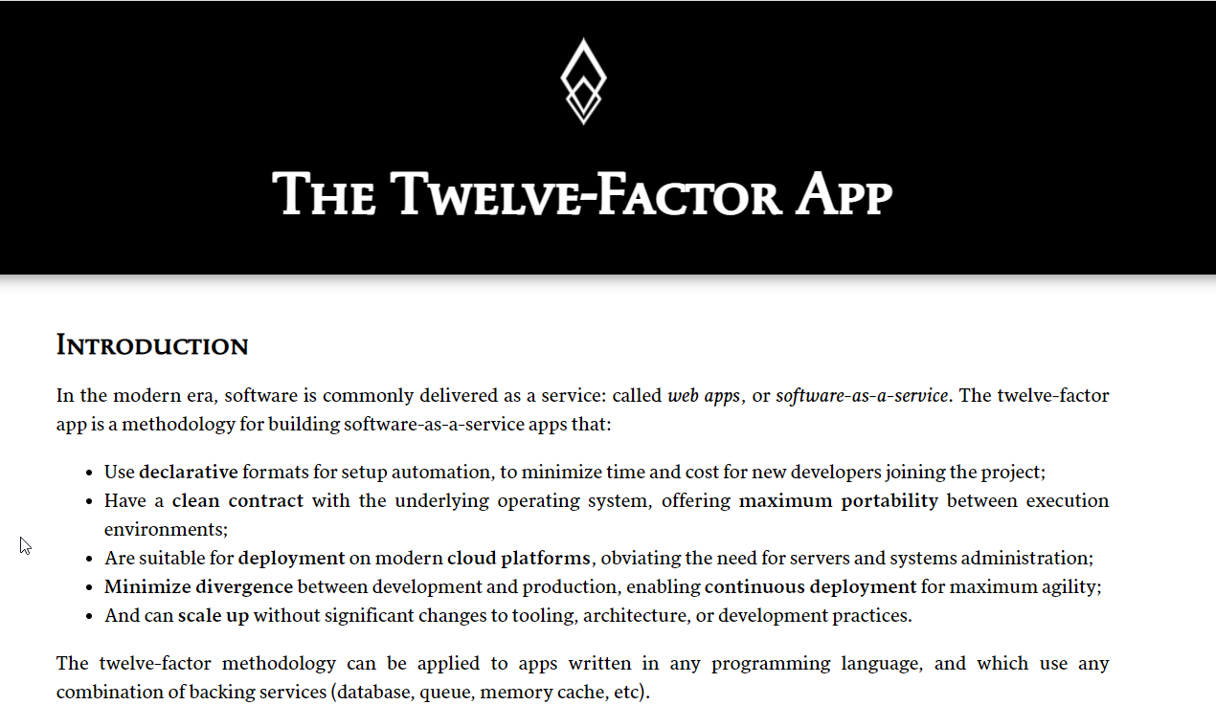

Why CF (3)
3
Support 12 Factor App
It is a strategy to build software-as-a-service
https://12factor.net/
A

Slide 12
History of CF
License: Apache 2.0
Build in Ruby, Java and Go
Open Governance Foundation
2009-2011
2012
2013
2014
2015
2019
2021
VMWare
BOSH
Open Source Tools
Seven platinum members and two gold members
40+ Members
65+ Members
Jan 2021
Pivotal Cloud foundry closes free trials
Pivotal
EMC
VMWare
General Electric

Slide 13
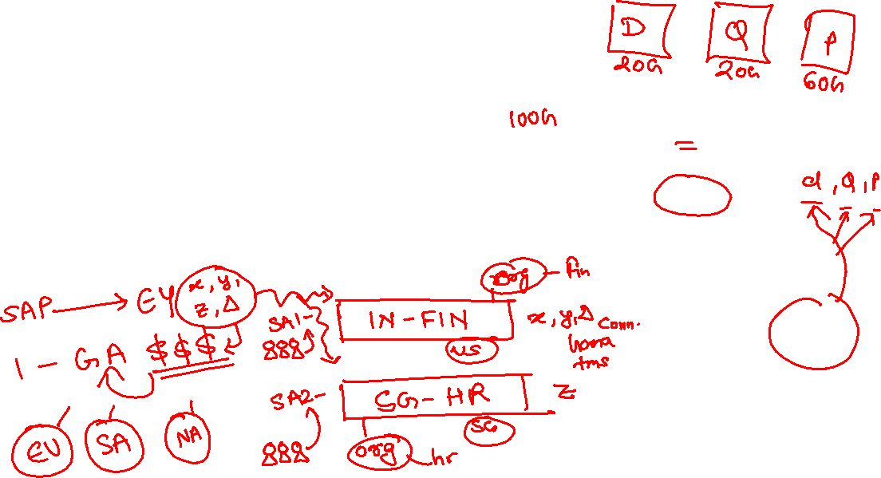
BTP Infrastructure from Customers View
Backing Services
Global Account
(Representation of customer for billing purpose)
Sub Account
(per region)
Specialized service offerings
Represents LoB
Space quotas
1 *
1 *
Space
1
*
Apps

Slide 14

Microservice v/s Monolithic Architecture
Design time
50GB ➔ 100GB
Application is safe even one part of app crash
We have choice of technology
Possible to scale individual services easily
Design time
ms1
ms2
ms4
ms3
www.anubhavtrainings.com

Slide 15
Uber
Driver App
Driver App
Passenger App
Passenger App
Cab Search
Payment Service
Cab Search
100GB
Payment Service
10GB
100 ➔ 80 ➔ 70 ➔ 69 ➔ 50 pay digital

Slide 16

Environment, Subscriptions & Instances
Environments
Environments constitute the actual platform-as-a-service offering of SAP BTP that allows for the development and administration of business applications. Environments are anchored in SAP BTP on subaccount level.
SAP BTP offers three environments: ABAP, Cloud Foundry and Kyma. Some existing customers still have Neo, but this is no longer offered.
Subscription based services
You will also see these ones called software as a service (SaaS), or multitenant applications. The experience here is that you subscribe to the service, and in return you receive a URL, from which you can access that service. Opening the URL brings you to a web application from which you can leverage the service. This is how other SaaS like SuccessFactors or S/4HANA Cloud work as well. They are also enabled at a subaccount level, and are independent of the environments. You don’t need to have Cloud Foundry enabled to subscribe to SAP Launchpad Service, for example.
Examples include Launchpad, SAP Business Application Studio, Cloud Integration, Process Automation…
Instance based services
These are the purest services. They provide a specific functionality, like databases, connectivity, authentication…. You connect your application to them to leverage that functionality. These services don’t provide a UI to manage them. Instead, they rely on API to connect to applications and other services and provide their services. They are provisioned inside an environment, so they are environment specific. Each environment has its own organization (for users and applications): In Cloud Foundry, instances are created inside a space. For Kyma, instances are created inside a namespace.
www.anubhavtrainings.com
Notes:
https://help.sap.com/docs/BTP/65de2977205c403bbc107264b8eccf4b/144e1733d0d64d58a7176e817fa6aeb3.html

Slide 17
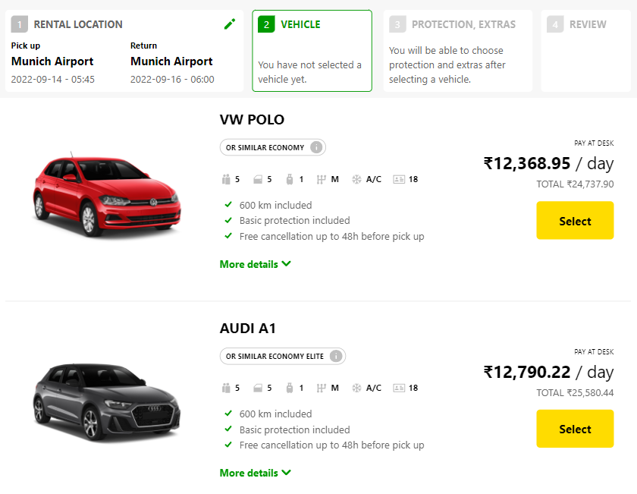
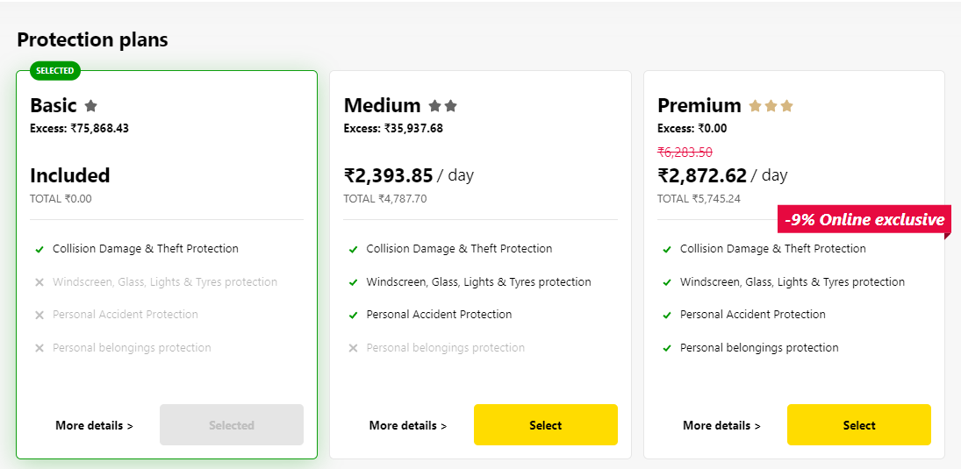
Backing Service
Each service has one or more service plans available. A service plan is the representation of the costs and benefits for a given variant of a particular service. For instance, a database may be configured with various "T-shirt sizes", each of which is a different service plan.
Choose Your service
Backing Service
Select Plan
Service Plan
www.anubhavtrainings.com

Slide 18


Backing service instance
Car key to use Car
Service Key to Consume Service instance
Actual Car
Service Instance
www.anubhavtrainings.com

Slide 19
BTP Service catalog
The SAP Discovery Center is a relatively new site hosted by SAP for developers and architects to find the services hosted by sap in SAP BTP and their respective service plans available.
It will also help technical team to identify the data center availability and cost associated with each service.
https://discovery-center.cloud.sap/#/serviceCatalog
www.anubhavtrainings.com

Slide 20

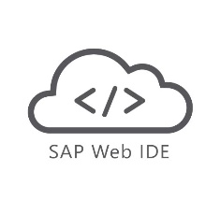

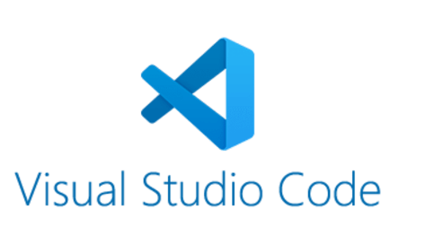
Development Tools
Development Tools
BAS is the latest technology provided by SAP for Development
Web IDE
VS Code
Business Application Studio (BAS)
It Installs in our local system and runs on the browser.
It requires JAVA 1.8 to be installed in system.
It runs offline.
Support for Web IDE is also stopped by SAP in 2019.
It installs in your local system.
It is one of the most used tools in the world by developers.
It is open source.
To develop Fiori Application you don’t need any subscription.
Have large number of plugins to support different languages.
SAP BAS is also based on VS Code.
SAP Business Application Studio is the next generation of the iconic SAP Web IDE.
It comes out of the box with predefined set of development environments – Dev-Spaces (virtual machine on the cloud) tailored for developing SAP business scenarios.

Slide 21
Installation of the Development Tools
VS code:
VS code a open source development tool (IDE) by Microsoft for developer community. Billions of developers across industry use this tool for all kinds of development (web, android, ERP apps, Fiori). Hence SAP also recommend to follow industry best practice. The BAS is a copy of VS Code (local BAS). If you adopt VS Code, you don’t need to buy SAP BAS subscription so it’s a cost saving for company.
Pre-requisites
Node JS to be installed (min v10) – node –v
Download and install NodeJS from here
We need to install SAP UI5 tooling used by Node JS (support module to work with ui5 apps) – npm install –g @ui5/cli
Steps to install VS Code
Download and install VS Code for free from here
Open the VS Code
Add A folder C:\UI5 Project\basics ← project name
Create webapp/index.html file and same content like Web IDE
Run following command by opening terminal in VS Code and go inside project directory
npm init
ui5 init
6. Inside the webapp folder, create a file manifest.json
7. Start web server using command ui5 serve

Slide 22
BAS – Business Application Studio
SAP BTP development is fully supported by a new tool introduced in 2020 called BAS (Business App Studio). It is inspired by Microsoft’s open source dev tool called VS Code.
BAS multi-cloud development tool, which can be used for verity of developments like
Java
Node JS
CAPM
UI5
Fiori
DB Tools
Workflow
Dev Space
Dev Space
Dev Space
Required tools to develop one kind of application.
1..*
workspaces
workspaces
workspaces
workspaces
workspaces
IaaS – AWS, Azure, GCP

Slide 24
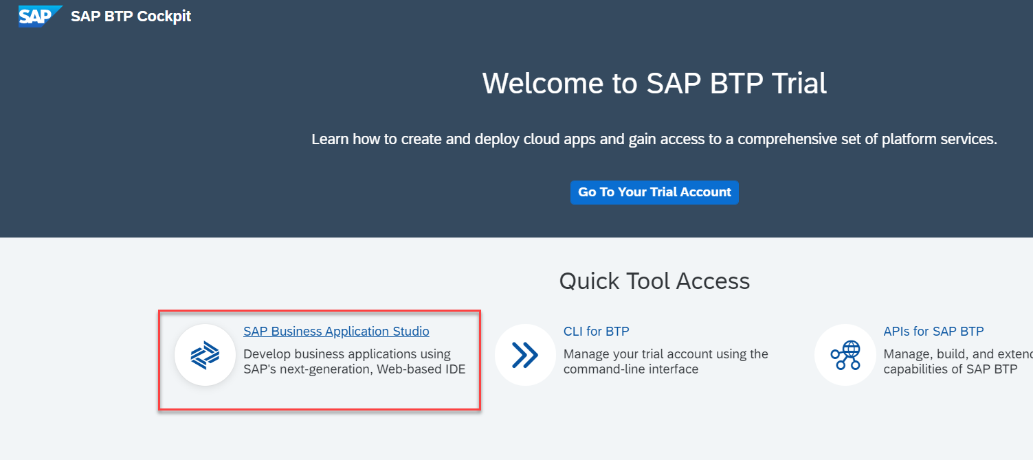
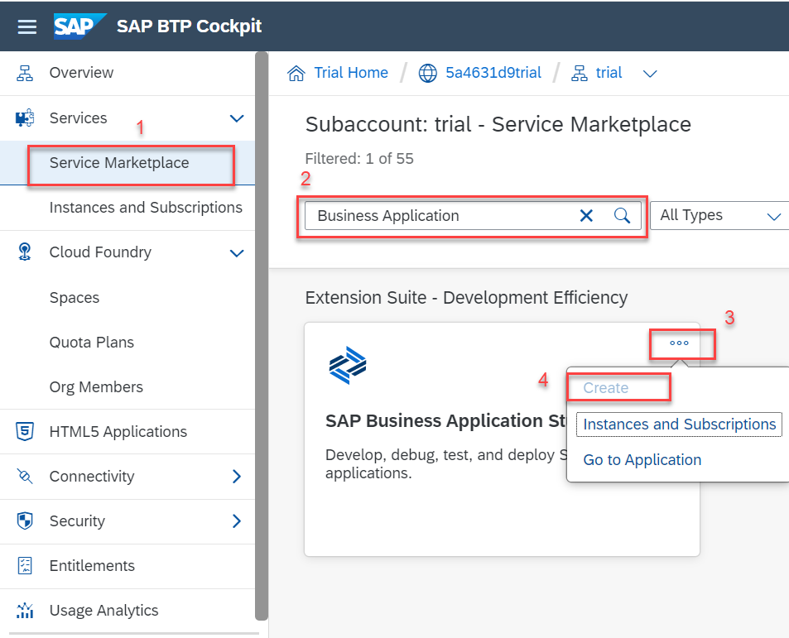
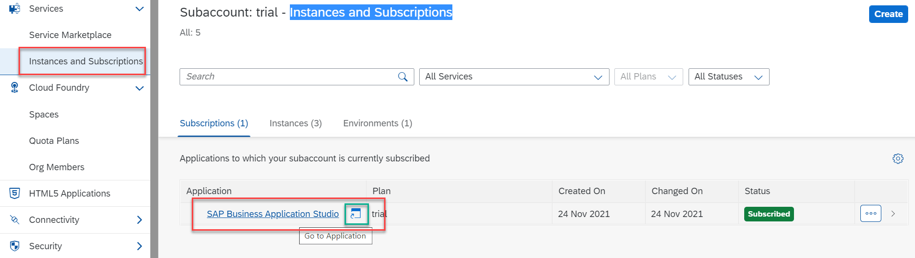
Accessing the BAS Tool
To Access the Business Application Studio we need to go on the home page of the BTP Trial account, and click on the Business Application Studio, it will navigate you to the BAS.
If you are not able to navigate to the BAS from home screen then go to your trial account and in trial account create a subscription for the BAS tool in service market place.
Note:- Its FREE.
Once the instance is created then go to the Instances and Subscriptions section and then start the Business Application Studio.

Slide 25
Additional Tools
Once the setup of Development tools is completed we need to install some other tools in our local system to support the command line interface for the Cloud Foundry and Git.
In BAS these tools are pre-installed.
But in VS Code we have to manually install these tools.
For Git setup: Go to the below link and download the git cli according to your system and install it.
Git Setup - https://git-scm.com/downloads
For Cloud Foundry CLI: Go to below link and download and install the cf cli according to your system type.
CF CLI (Command Line Interface) Tool – allows to communicate/connect to CF
https://github.com/cloudfoundry/cli/wiki/V6-CLI-Installation-Guide
CF CLI help Documentation
https://docs.cloudfoundry.org/cf-cli/getting-started.html

Slide 27
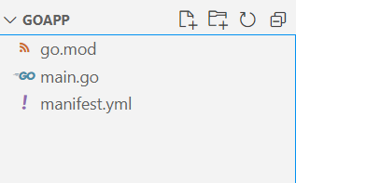
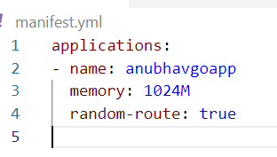
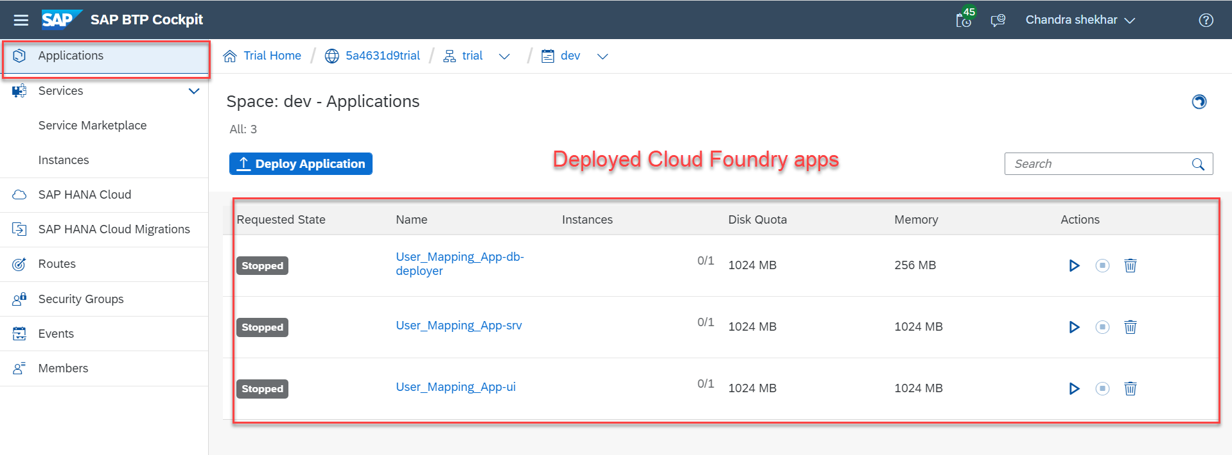
Deploying Sample Application to CF
We will deploy a sample application based on the Go Programming Language.
For now we are just using a basic application. It contains only three files:
go.mod
main.go
manifest.yml
The first two files are some program file, for now we are not focusing on what is written it those file.
The third file is manifest.yml is the most important file in the Cloud Foundry application. It contains the information about application instance, the build pack of the app, route name, memory size required etc.
Steps to deploy the app:
Navigate to the app folder in terminal.
Enter Command ‘cf login’ to login to Cloud foundry.
Enter your login detail
Select the dev space on which you will deploy the app.
Enter command ‘cf push’ to deploy the app to Cloud Foundry.
Once the deployment is successful you can check the application in the BTP’s Application Section.

Slide 28

Hands-on: Deployment of Sample App to CF
In this exercise we will deploy a GO application on the cloud foundry platform.
Exercise code/resource:
GoApp

Slide 29
































Slide 30

What is NodeJS?
Node JS is an open-source, cross platform, JavaScript runtime environment and used to execute JavaScript on Server Side.
Node JS is a framework which allows us to run JS code outside browser. The main benefit is that a development do not need to learn multiple programming languages. If we know JS, we can code both client and server side in same language.
Node JS is also a great web framework for beginners because it works great for data intensive applications like streaming, gaming and real time apps. It leverage the power of JS’s Asynchronous no blocking IO.
Application of Node JS
Build Backend Application Logic
Host a Web Server (express)
Send Emails
DB lookup
Automation
Output to the user
Use its eco-system like PDF, EXCEL, EMAIL…
Install NodeJS in our system form here https://nodejs.org/en/, if you using bas, you do not need to install as BAS already has NodeJS preinstalled.
If we want to achieve something, this something was already achieved by someone, somewhere else in the world, they have already published it as a node module which we can import and reuse. We get ready-to-use code for consumption for speedy development. https://npmjs.com

Slide 31
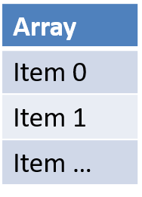
Basic of JavaScript
JS is case-sensitive (80% developers does case-sensitive errors)
Every statement in JS ends with semi-column
JS Naming convention is camel case, the first letter of any word is small, next consecutive word’s first letter is caps.
Ex:-
iloveindia ➔ iLoveIndia
wearelearningJS ➔ weAreLearningJs
An array is a collection of values, each value is an item of an array. The index of first item always starts with zero (0)
Syntax for Array
var aItems = [item0, item1,….]
Ex:
var myArr = [1, 2, 3, 4, 5];
var myArr2 = [‘a’, ‘b’, ‘c’];
Objects are like structures to contain multiple fields of different kinds.
Syntax for object
var oObjName = { “prop”: value,
“prop”: value,
“prop”: value }
Example of an Object
{
"empStructure": {
"empNo": 100001,
"empName": “Anubhav",
"salary": 5000,
"currency": “USD"
}
}
We can verify the structure of our JSON on : https://jsonlint.com/

Slide 32

Exercise
In this exercise we will create a new JavaScript and we will see some basic concepts of java script related to variables in JS and along with that will see how to work with Arrays and Objects in JavaScript.
Part 1: Basics of JavaScript
sample.js
Part 2: Working with Arrays in JS
sample.js
Part 3: Working with Objects and Array of Objects in JS
sample.js

Slide 33
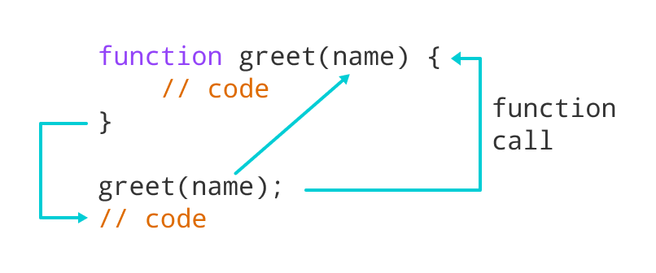
Functions in JavaScript
Functions in JavaScript
A JavaScript function is a block of code designed to perform a particular task.
A JavaScript function is executed when "something" invokes it (calls it).
A JavaScript function is defined with the function keyword, followed by a name, followed by parentheses ().
The code to be executed, by the function, is placed inside curly brackets: {}
Function parameters are listed inside the parentheses () in the function definition.
Function arguments are the values received by the function when it is invoked.
Inside the function, the arguments (the parameters) behave as local variables.
Types of functions
Functions are of 2 types →
1. Anonymous function
function(params) {
//code
}
2. Named Function
function functionName(params) {
//code
}

Slide 34
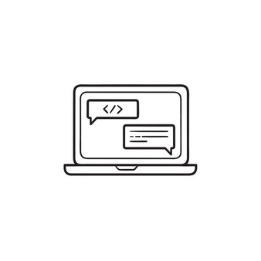
Exercise
In this exercise we will see how we create functions in JavaScript and what are the different syntaxes of defining the functions. Along with that we will see the concept of reusable modules in NodeJS and with that we will see the use of Global Variables.
Part 1: Named Function Basics
FunctionBasic.js
Part 2: Concept of Reusable module in NodeJS
FunctionBaisc.js
reuse.js
Part 3: New Syntax of defining function and Global variable
FunctionBasic.js
JS is asynchronous Non Blocking Programming language. Also is an event driven programming language.
Server
Java
ABAP
Client
Java Script
Node JS
Java Script

Slide 35
Asynchronous behavior of JavaScript
UI
Module
w
async
Util (in-built)
Callbacks
Promise

Slide 36
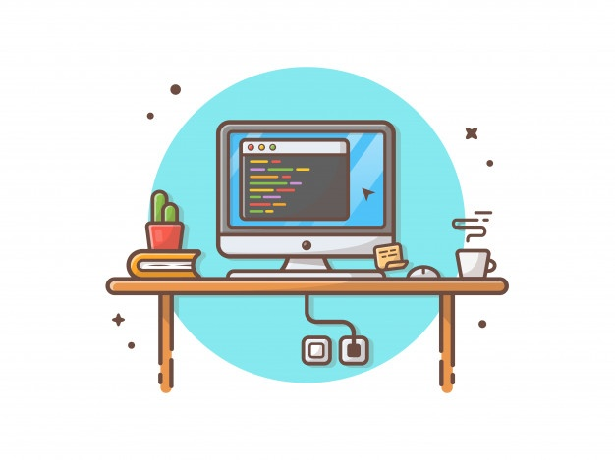
Exercise
In this exercise we will see the asynchronous behavior of JavaScript. We will see the use of Callback function and Promise in JavaScript. Along with that we will see the JavaScript’s reusable module ‘util’ to promisify a function.
Part 1: Concept of Callback Function
AsyncFunciton.js
Part 2: Concept of Promise in JavaScript
AsyncFunction.js
Part 3: Promise using a reusable module.
AsyncFunction.js

Slide 37

Concept of Events in NodeJS - Exercise
Node.js has an event-driven architecture which can perform asynchronous tasks. Node.js has ‘events’ module which emits named events that can cause corresponding functions or callbacks to be called.
In this exercise we see how to use events in NodeJS. We will see Simple events as well as How to use events in Real life examples.
Part 1: Simple Event Example
EventConcept.js
Part 2: Event Concept using Real Life example
EventConcept.js

Slide 38
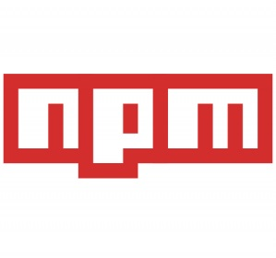
NPM – Node Package Manager
Node Package Manager (NPM) is a command line tool that installs, updates or uninstalls Node.js packages in your application. It is also an online repository for open-source Node.js packages. The node community around the world creates useful modules and publishes them as packages in this repository.
npm is the world's largest Software Registry.
The registry contains over 800,000 code packages.
Open-source developers use npm to share software.
Many organizations also use npm to manage private development.
npm is installed with Node.js
NPM is included with Node.js installation. After you install Node.js, verify NPM installation by writing the following command in terminal or command prompt ‘npm –v’
https://www.npmjs.com/

Slide 39
Access Global Node JS Modules
We can add the Global modules present on the NPM repository in our project.
To include the modules in our project we can use the following npm command:
‘npm install <moduleName>’
This command will Keep the module within the project, if we want to use that module in another project then we have to install it again in that project also.
Now if we want add a module which can be shared within all the projects, then we have to install that module globally in our system. To do that we have to use the following npm command:
‘npm install –g <moduleName>’
If there is a utility, command line tools we install them globally
package.json
project
project
project
local
global
global
module
Package.json file
Information about our project name, author, version
All the dependencies required by this node project
When we deploy our project in another system/machine we can use npm install command
module

Slide 40
Steps to create a Fresh NodeJS Project
Run a command called npm init – Create a new Nodejs project
Answer some simple questions like project name, starring file, author, version, description, …
As we mentioned that our starting file will be index.js. So now we have to create a new file named index.js.
We can just add some code to this file with all the modules
Then we run npm install moduleName --save OR npm install moduleName --save-dev to add a module to our project.
To run the project, we can use the ‘node .’ command in the terminal.
Exercise: In this exercise we will create our first NodeJS project following the above steps.
index.js
Phase 2 – Create a webserver and microservice using ‘express’
Install express module and add that as dependency also to our project npm install express –save
You can check package.json and you will find dependencies
Use express module to create web server (refer index.js file)

Slide 41
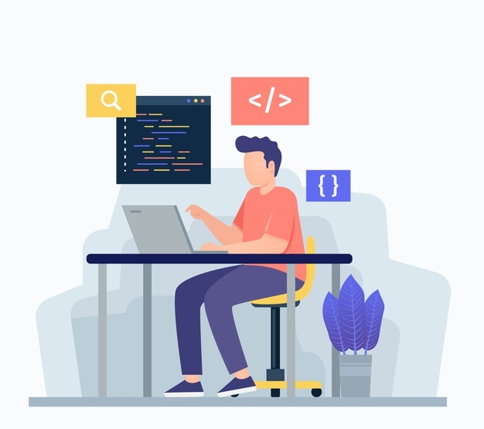
Exercise
In this exercise we will create a simple microservice using the NodeJS and express server module.
Part 1: Creating a Simple NodeJS app with express server
index.js
Part 2: Creating a Microservice which return a JSON data
index.js

Slide 42

End of Day 1

Slide 43

Questions

Slide 44

Anubhav Oberoy

Slide 45


We’re committed to empower you to be
Most Desirable Resource
through powerful training solutions.
We build the workforce of the future.
250+
Corporate Clients
30,000+
Learners Trained
25000+
Learners Placed
FREE WEBINARS
Sign up for free webinars with industry experts every fortnight!
Enroll Now!
Contact us today!
https://anubhavtrainings.com/

Slide 46




More from AnubhavTrainings.com

Slide 47
Title
Content

